Slide 1
INTRODUCTION TO TEST AUTOMATION AND DEVOPS: A CASE STUDY
Robert Taylor
robert.taylor@bluevolt.com
10/14/2019

Slide 2
Robert Taylor – Jr. Automation Engineer
B.S. Computer Science
Portland Indie Game Squad
Black Box testing for major label games
BlueVolt – Jr Automation Engineer
Introduced different types of automation
Experienced UAT testing
Intern knowledge source
Notes:
Presenter’s level of expertise in the subject: Briefly state your credentials in this area, or explain why participants should listen to you.

Slide 3
Agenda
Test Automation
What is Test Automation and what is expected
Perks and benefits of Test Automation
DevOps
What is DevOps?
DevOps objective
Combining Test Automation and DevOps
Challenges faced by beginning Automation Engineers
Notes:
How presentation will benefit audience: Adult learners are more interested in a subject if they know how or why it is important to them.
Presenter’s level of expertise in the subject: Briefly state your credentials in this area, or explain why participants should listen to you.

Slide 4
What is Test Automation
“… automating the tracking and managing of all those testing needs, including how much of the system different tests cover and what other types of testing might be required to cover all the moving parts.” ^{[1]}
⁻McMeekin, Kyle. “Test Automation vs. Automated Testing: The Difference Matters.” QASymphony. https://www.qasymphony.com/blog/test-automation-automated-testing/ (accessed October 7th, 2019)
Notes:
[1]McMeekin, Kyle. “Test Automation vs. Automated Testing: The Difference Matters.” QASymphony. https://www.qasymphony.com/blog/test-automation-automated-testing/ (accessed June 15th, 2019)

Slide 5
Benefits of Test Automation?
Release faster and increase deliverability
Increase test coverage to improve overall product quality
Efficient testing producing applicable results
Notes:
Image - https://xbosoft.com/software-testing-services/test-automation/

Slide 6
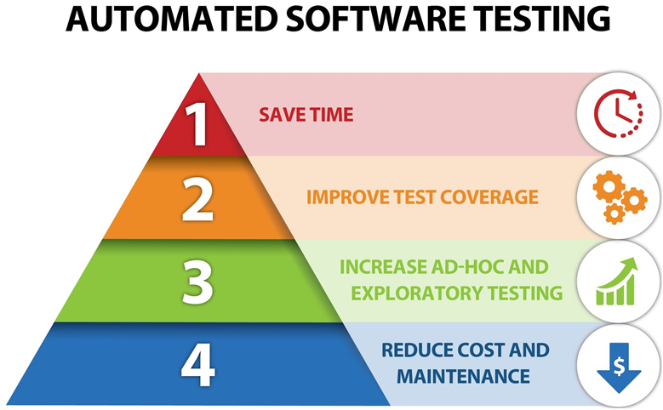

Slide 7
How to get started: Test Automation Process

Slide 8
Notes:
Image:https://artoftesting.com/manualTesting/automation-testing.html

Slide 9
Requirement Understanding
Learn about the company
Goals, Objectives, Slogans, ect… (“Knowledge Powers Growth”)
Learn about the product (or feature) that the company is producing
How the product interacts and reacts with users
Find the pain points
Understand why they are THE pain points
Figure out the different software and hardware components the test will interact with
Notes:
Image: medium.com/@karlwiegers/defining-project-scope-whats-in-what-s-out-aa8031f6a904

Slide 10
Defining Scope of Automation
Understand how a manual test would function
Choose the right test cases to automate
What to and what not to test
Explore testing techniques
Notes:
Image: medium.com/@karlwiegers/defining-project-scope-whats-in-what-s-out-aa8031f6a904

Slide 11
Selecting the Right Tool
Determining what tools to use
Project requirement
Programing expertise
Project budget
Notes:
Image: s3.amazonaws.com/files.haikulearning.com/data/lacoe/minisite_14659670/d3e773aed8c68/3-4_tools/index.html

Slide 12
Framework Creation
Scripts vs Data
Libraries
Best practices
Plan for the Future (Scalability)
Maintenance
Versioning

Slide 13
Scripting Test Cases
Testing Techniques
Testing Tools
Golden Path (Happy Path)
Edge Case Testing
Smoke Testing
Combinatorial Testing
User Testing
Performance Testing
Stress Testing
Selenium/Protractor
JMeter
Python
JavaScript

Slide 14
CICD Integration
Notes:
Image: about.gitlab.com/product/continuous-integration/

Slide 15
How to get started: DevOps
Notes:
Image: about.gitlab.com/product/continuous-integration/

Slide 16
What is DevOps?
Combination of Development and Operations
Increased communication
Better collaboration
Cohesion between different entities
Ops
Dev
DevOps
Product
Testing
Notes:
Image: https://krify.co/tag/key-features-of-devops/

Slide 17
Apply DevOps!
“DevOps doesn’t confine itself to technical implementation and execution of testing and development activities. It is a cultural shift that is needed to ensure that the strategy is collaborative and closely monitored. Developers and operations need to work together to reduce inefficiencies and bring speed to the development activity.”
“4 ways to Automate Testing in a DevOps set-up“ Cigniti Trvhnologies. https://www.cigniti.com/blog/4-ways-to-automate-testing-in-devops-set-up/ (accessed October 8th, 2019)
Notes:
“4 ways to Automate Testing in a DevOps set-up“ Cigniti Trvhnologies. https://www.cigniti.com/blog/4-ways-to-automate-testing-in-devops-set-up/ (accessed June 19th, 2019)

Slide 18
DevOps Tools and Applications
At BlueVolt
Azure DevOps
Azure Portal
Jenkins
SonarQube
Pingdom
New Relic
Akamai

Slide 19
Notes:
Image: https://krify.co/tag/key-features-of-devops/

Slide 20
Combining Test Automation and DevOps

Slide 21
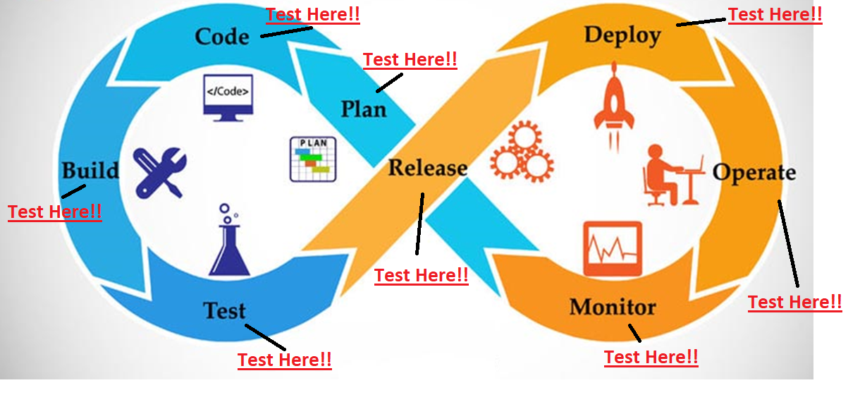

Slide 22
Challenges Faced by Beginning Automation Engineers

Slide 23
Where do I begin?
Learn the product!
Who is the target audience?
What issues is the product trying to solve?
What stack is the product developed in?
What are the pain points within the company?
What is the company trying to deliver?
What issues will automation solve?
When should automation be used?
How will it affect the desired product?

Slide 24
How do I begin working on test automation, pipelines or a combination of both?
Create steppingstones (smaller tasks)
Speed up creation/integration
Purpose of the task
Where it will live
Resources needed
Additional tools required
Keep pushing forward
Review prior tasks to improve them

Slide 25
After finishing one task, what do I do next?
USE IT!
REFINE!
USE IT!
REFINE!
USE IT!
REFINE!
Notes:
Implement what was just created!!
Refine upon it, it is an Agile process.

Slide 26
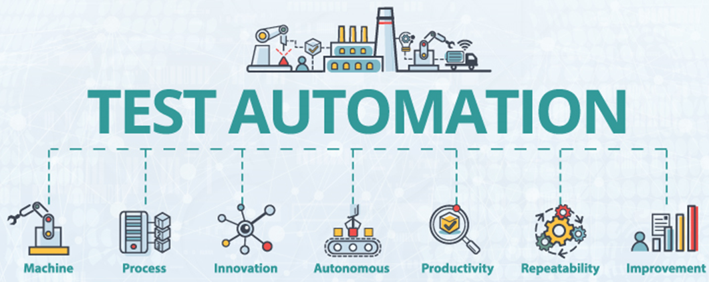
Conclusion – Test Automation
Notes:
https://www.testing-whiz.com/blog/understanding-the-dynamics-of-automation-testing-when-how-and-why

Slide 27
Conclusion – DevOps

Slide 28
Questions?
Identify what testing can improve
Automate testing
Higher Quality Products

